Slide 1
Geo Location
Latitude and Longitude

Slide 2
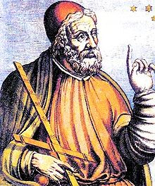
System of Coordinates
The ancient Greek geographer Ptolemy created a grid system and listed the coordinates for places throughout the known world in his book Geography.
The actual the latitude and longitude system was developed and implemented in the middle ages.
This system is written in degrees, using the symbol °

Slide 3
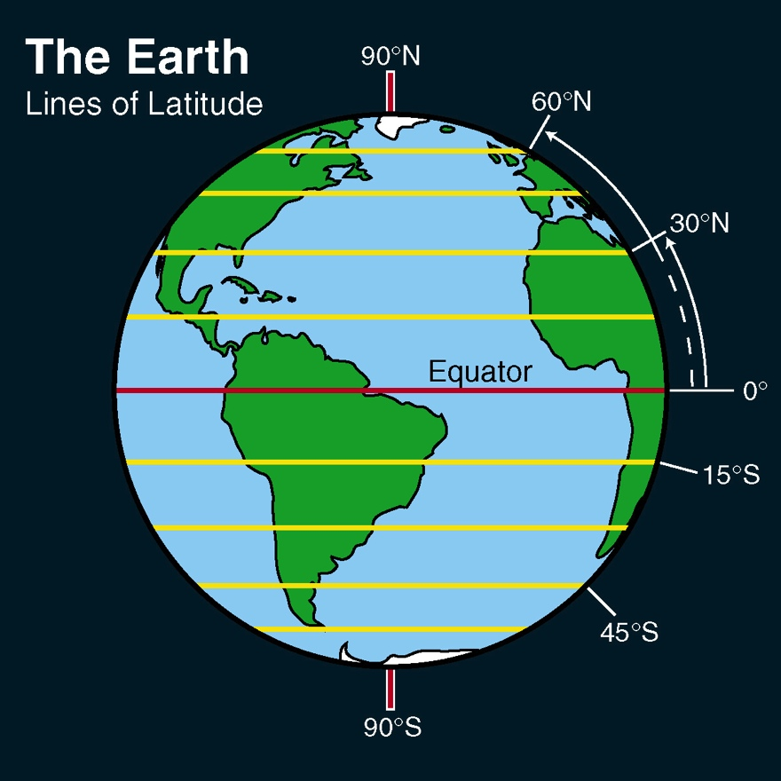
Latitude
Latitude lines run horizontally.
Latitude lines are also known as parallels since they are parallel and are an equal distant from each other.
Each degree of latitude is approximately 69 miles (111 km) apart;
The earth is not a perfect sphere but an oblate ellipsoid (slightly egg-shaped) hence there are minor variations.

Slide 4
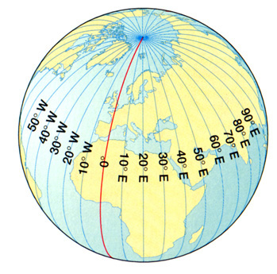
Longitude
The vertical longitude lines are also known as meridians.
They converge at the poles and are widest at the equator (about 69 miles or 111 km apart).
Zero degrees longitude is located at Greenwich, England (0°).
The degrees continue 180° east and 180° west where they meet and form the International Date Line in the Pacific Ocean.
Greenwich, the site of the British Royal Greenwich Observatory, was established as the site of the prime meridian by an international conference in 1884.

Slide 5
Crack the Code Activity
Get in groups. 11 groups of 2 and 1 group of 3
Choose your code
Your code is the list of coordinates for cities all over the planet.
(1) Find those places in Google Earth.
(2) As you find each place, write its name next to the coordinates.
(3) Circle the first letter of each name.
(4) Read the letters from top to bottom, and they should spell the name of a mystery city.
(5) Find that city in Google Earth and see it in 3D

Slide 6
Tips
Make sure 3D Buildings box is checked under Layers
To make it a little easier in Google Earth you will need to go to
ON PC: Tools – Options- 3D View Tab. Locate Show Long/Lat and make sure the Degrees button is selected
ON MAC: Google Earth-Preferences-3D View. Locate Show Long/Lat and make sure the Degrees button is selected

